Slide 1
Simulation Modeling Analysis
Introduction to Queuing
Systems
Md. Fazlul Karim Patwary
Professor
Institute of Information Technology Jahangirnagar University

Slide 2
Queueing Systems
In communication networks, network media or resources are often shared by many user, leading to conflicts or queues
Communication networks can be modeled as queuing systems
The tool we use to analyze the queuing systems is
“Queuing Theory”
Basic Elements of a Queueing System
Customer
Queue (buffer)
Server

Slide 3
Example: Single Server Queues
Customers arrive at a bank with a single teller and get served.
What is the average waiting time in the bank?
What is the average number of customer waiting in the bank?
Bank
teller
queue
begin served

Slide 4
Different Kinds of Queueing Systems
Single-Buffer, Single-Server Single-Buffer, Multiple-Servers
Customers
Customers
•••
Buffer
Server
Buffer
Servers
Multiple-Buffers, Multiple-Servers
Zero-Buffer, Multiple-Servers
Customers
Customers
•••
••
Servers
Buffers
Servers

Slide 5
Description of a Queueing System
Two events: Arrival & Departure
Arrival Process
τ₂
τ_{i}
^{τ}i+1
a
a
…
ªi-1
2
a_{i}
ªi+1
t
1
a_{i} = arrival time for the i-th customer
τ_{i} = a_{i} – a_{i-1}= interarrival time between the i-th and (i-1)-th customers
Departure Process
d
d
… _{d}
1 2 n-1
d_{i}
^{d}i+1
t
d_{i} = departure time for the i-th customer

Slide 6
How to Represent the System
State variables
n_q(t): number of customers waiting in the queue at time t
n_s(t): number of customers being serviced at time t
n(t): number of customers in the system at time t
n(t) = n_{q} (t) + n_{s} (t)
w_i: delay (waiting time) of user i in the queue
s_i: service time of user i in the server
t_i: the time spent by user i in the system (response time)
t_{i} = w_{i} + s_{i} = d_{i} − a_{i}

Slide 7
Single Server Queue
n(t) No. of customers in the system s₁ s₂ s₃
w₂
Server idle
4
3
2
1
w₁=0
w₃
a₂ a₃
d₁
d₂
a₄
d₃
d₄
a₅
…
t
τ ª1 τ
τ
τ
1 2
3
4
t₁
t
2
Typical performance measurements:
Waiting time
System time
Throughput: number of customers served per second

Slide 8
Model the Arrival Process of the Customers
The most common process used to model the customer arrival is the Poisson Process
When will customers arrive according to a Poisson Process?
A lot of customers acting (statistically) independently and identically, and each has small probability to arrive.
Poisson Process has only one parameter
λ – “arrival rate”: The average number of arrivals per unit
time

Slide 9
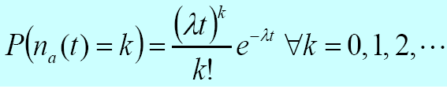
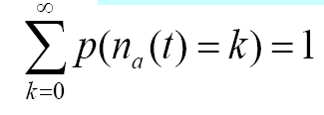

Poisson Distribution
n_a(t): number of customers that arrive during time interval t
The probability that there are k arrivals during time interval t
The expected number of arrivals during time interval t is

Slide 10
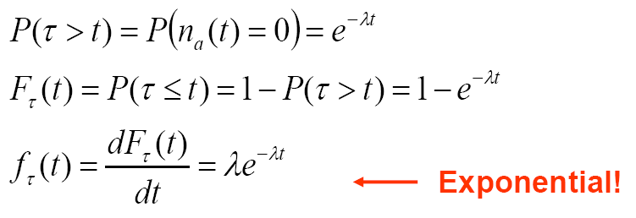
Distribution of the Inter-arrival Time
The inter-arrival time of a Poisson process (time interval between two successive arrivals) follows exponential distribution
The mean (expected) inter-arrival time is 1 /λ
Example: if the mean arrival rate is 2 customer / minute, then the mean inter-arrival time is 0.5 minute

Slide 11
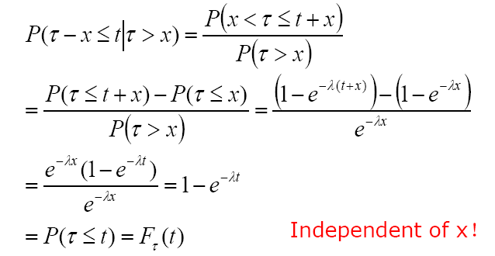
Memoryless Property of Exponential Distribution
Suppose that buses arrive at a bus stop according to a Poisson process. A passenger arrives at t=0
On average, how much longer s/he has to wait until a bus arrives, if s/he already waits for x amount of time?
Exercise: Compute the distribution of the residual time until the next arrival.

Slide 12
Memoryless Property of Exponential Distribution
Exponential distribution is also widely used to model the
service time of a customer (the time spent in the server)
Simplifies the analysis of a queueing system
We don’t have to know how long a customer has been served in order to predict when it finishes

Slide 13
Notations and Terms of Queueing Systems
Kendall notation:A/S/m/B/K/SD
A: interarrival time distribution
M: memoryless (exponential)
D: deterministic
Er: r-stage Erlang …
S: servicing time distribution
M: memoryless (exponential)
D: deterministic
Er: r-stage Erlang
G: general …
m : Number of servers

Slide 14
Notations and Terms
B : System capacity (maximum total number of users accommodated in the system)
If not specified, assume to be infinity
K : Customer population
If not specified, assume to be infinity
SD: Service discipline
FCFS: First come first served
LCFS: Last come first served (stack)
Priority queue --- different classes of customers have different priorities
Non-preemptive: the arriving customer, even with higher priority, has to wait until the current customer in the server leaves
Preemptive: customer in the server is ejected when a customer with higher priority arrives.

Slide 15
Notations and Terms of Queueing Systems
Example:
■ M/M/1
Exponentially distributed inter-arrival time, exponentially distributed service time, single server, infinite buffer size and population
■ M/D/2/10
Exponentially distributed inter-arrival time, deterministic service time, 2 servers, system capacity 10, infinite population size
M/Er/5/10/100: Exponentially distributed inter-arrival time, r- stage Erlang distributed service time, 5 servers, system capacity 10, customer population size 100

Slide 16
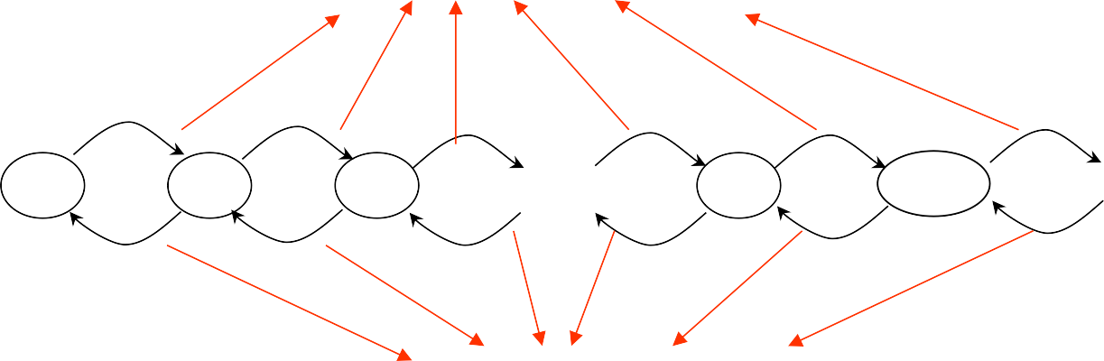
Representation of a Queueing System
Describe the evolution of a queuing system by a Markov chain
A Markov chain is consist of
A state space, e.g., each state is the number of customers in the
system
Transition probability/rate: How the system transits among the states
Markov property: given the present, the future and the past are independent
λ_{k}: average arrival rate when there are k users in the system
State transitions due to arrival events
λ₀
λ₁
λ₂
^{λ}k−1
λ_{k}
μ_{k}: average departure rate when there are k users in the system
…
…
0
1
2
k
k+1
μ₁
μ₂
μ₃
μ_{k}
^{μ}k+1
State transitions due to departure events
18

Slide 17
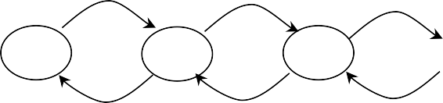
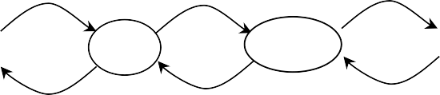
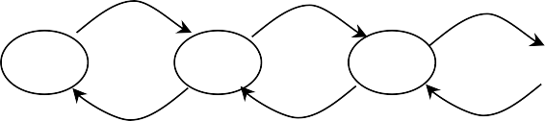
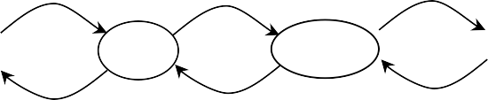
State Diagrams
M/M/1 Queue:
λ
λ
λ
λ
λ
…
k+1
0
1
2
k
μ
μ
μ
μ
μ
M/M/∞ Queue:
λ
λ
λ
λ
λ
…
0
1
2
k
k+1
(k+1)μ
μ 2μ
μ: service rate of each server
3μ
kμ

Slide 18
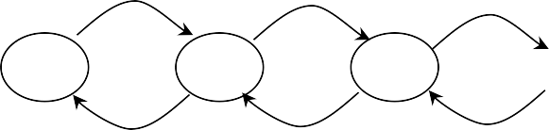
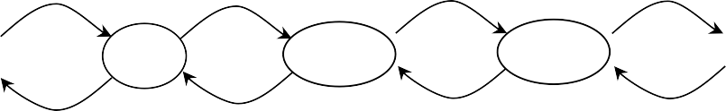

State Diagrams
M/M/m Queue:
λ
λ
λ
λ
λ
…
0
1
2
m
m+1
m+2
2μ 3μ mμ
M/M/m/m Queue: finite servers, no buffer
mμ
mμ
λ
λ
λ
λ
λ
…
0
1
2
m-1
(m-1)μ
m
μ
2μ
3μ
mμ

Slide 19
Little’s Law
Notations:
N: Mean number of customers in the system
Q: Mean number of customers in the queue
R: Mean number of customers in the server
N=Q+R
T: Mean response time that a user spent in the system (from arrival to departure)
W: Mean waiting time of a customer
S: Mean service time of a customer
T=W+S
λ: Mean customer arrival rate
μ: Mean service rate

Slide 20
Little’s Law
Little’s Law:
Mean number of customers in a (sub)system = arrival rate * mean time that a customer stays in the (sub)system
Little’s Law is based on a black-box view of a system
Black Box
Arrivals
Departures
The law applies as long as the number of jobs entering the system is equal to those completing services
this is called the job flow balance assumption
i.e. no new jobs are created in the system
no jobs are lost due to finite buffers

Slide 21
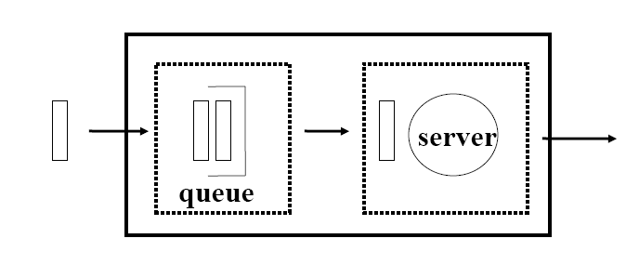
Little’s Law
Little’s Law applies to any system or subsystem
applies to queue:
Q = λW
applies to server: R = λS
applies to entire system:
N = λT

Slide 22
Little’s Law Is very General
No assumptions on
the arrival process
the service time distributions at the servers,
the network topology,
the service order,
Essentially assume nothing!
Black
Box
Arrivals
Departures
N = λT

Slide 23
Example
The arrival rate of visitors to an exhibition hall is 100 per minutes, and on average each visitor spends 1 hour in the hall.
❐ λ = 100/min = 6,000 / hour
average time in the system = 1 hour
average number of people in the system
= 6,000 * 1 = 6,000

Slide 24
Utilization Law
Let C be the number of completions during a total time, then utilization factor
_{ρ =} busy time ₌ C busy time
total time total time C
⇒ ρ = X S = λ/μ
Example: Customers arrive to a single-teller bank at a rate of 100 per hour, and the teller takes an average of 30 seconds to process the work for each customer
ρ =100/3600 *30 =5/6

Slide 25
A Simple Queueing Problem
Suppose the arrival rate (λ) of customers is 60/hour
the maximum servicing rate (μ) of the teller is 90/hour (or average servicing time = 2/3 min)
What is the average time a customer spent in the bank?
depends on the traffic’s pattern !!
If customers arrived in an orderly fashion
no queue, no delay !
teller

Slide 26
A Simple Queueing Problem
However, customers arrived in random order in practice
teller
bursty arrival, formed queue
queuing delay depends on the distributions of the inter- arrival time and service time
but the exact distributions are not known, unless we bother to take some measurements
Exercise: Calculate the average queuing delay without knowing the arrival distribution?

Slide 27
M/M/1 Queue
Yes !
by assuming that the arrival of customers are independent
by assuming a memoryless fixed-capacity server
If this is the case, then
let N = the average number of people in the system
(including the one in service)
for a new customer arrives to the system, the customer is expected to wait for W seconds, where
W = NS
T = S(1+ N)
Response time
Service time

Slide 28
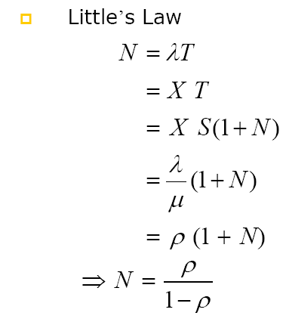
A Simple Queueing Problem

Slide 29
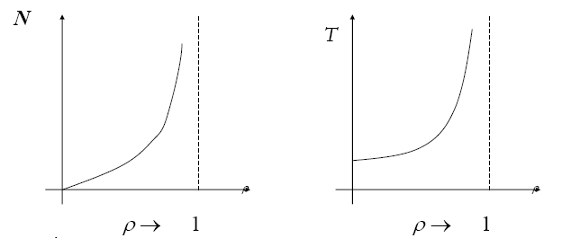
Motivation
The system is unstable system if ρ > 1
❐ if ρ > 1:
arrival rate > departure rate
queue length increases
unbounded queue length
unbounded waiting time

Slide 30
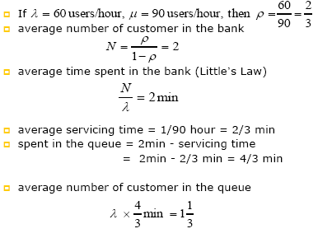
Example: Bank

Slide 31
Example: Queueing Delay in a Network
The queueing problem for fixed capacity service center is very common
Bank, assembly line, server, database, network
router |  | router
packets
1 km
packet arrival rate = 100 packets/s
what is the delay in sending the packets from one router to the other?
Three kinds of delay
Propagation delay: due to the finite propagation speed
Processing delay: the router needs time to process the IP head
Queueing delay: packets arrive randomly

Slide 32
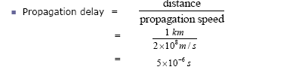
Example: Queueing Delay in a Network
Assume that a router can process IP heads at 1000 packets/s
Processing delay = 0.001s

Slide 33
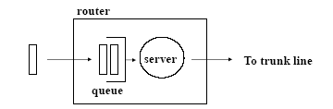
Example: Queueing Delay in a Network
How about the queueing delay?
Servicing time of a packet
if the average packet size is 1 K bytes (8000 bits)
Bandwidth of the exit trunk line = 1Mbps
time to transmit a packet to the trunk line
= 8000/1,000,000 = 0.008 s

Slide 34
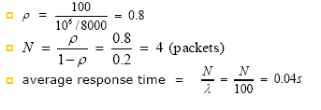
Example: Queueing Delay in a Network
Utilization factor (ρ)?
Arrival rate: 100 packets/s
Service rate: 1M/8000 packets/s

Slide 35
Example: Queueing Delay in a Network
processing delay
propagation delay
queueing delay
= 0.001 s
= 0.000005 s
= 0.04 s
queueing delay is the most significant delay in this particular example,
to reduce this delay, needs higher bandwidth (so as to reduce ρ )

Slide 36
Summary
Queuing theory works for idealized and simplified model
needs to assume that packets are independent
but frequently a big file is divided into many smaller packets, so the arrivals of these packets are correlated, not independent
needs to assume the servicing time of the trunk is
exponentially distributed
has to assume the file size follows an exponential distribution
Otherwise solutions become very complicated
Better to use computer simulation

